Slide 1
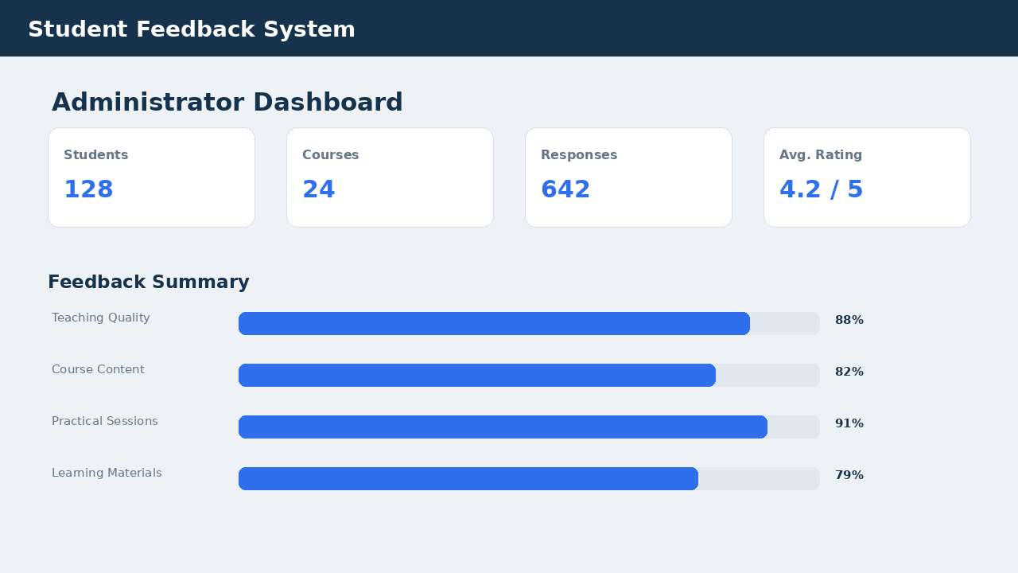
SUMMER INTERNSHIP REVIEW | IT3711
Student Feedback System using Python
A digital workflow to collect, validate and analyse course feedback with Python, Tkinter and SQLite
Administrator dashboard (sample output)
Logeshkumar M (810023205060)
Collect
Validate
Report
B.Tech. Information Technology, Semester VII
University College of Engineering (BIT Campus), Anna University, Tiruchirappalli
Notes:
Introduce yourself and the project: a Python desktop application that replaces a manual student feedback process with a digital workflow, built during the internship at Fantasy Solution, Trichy.

Slide 2
Internship at a Glance
THE ORGANISATION
DURATION
PROGRAMME
Fantasy Solution
1 - 30 June 2026
Python Programming
Software development and training, Trichy
An IT solution and service provider offering application development, web design and hosting, ERP implementation, testing, and IT education and training.
30-day internship
Software application development
JOINT SUPERVISOR
PROJECT
Mohamed Ibrahim
Student Feedback System
No 16, Samnath Plazza, Third Floor, Melapudur, Trichy-1
Software Developer, MCA
Python, Tkinter and SQLite
Notes:
Fantasy Solution, Trichy. Internship from 1 to 30 June 2026 in Python programming, under joint supervisor Mohamed Ibrahim (Software Developer, MCA). The project is the Student Feedback System.

Slide 3
Objectives of the Internship
1
2
3
Software lifecycle
Modular Python
Feedback workflow
Understand the development lifecycle followed in a professional environment
Strengthen Python skills and build modular applications
Design and implement a digital student feedback workflow
4
5
6
Database operations
Validation and security
Testing and docs
Create, insert, retrieve and update data using SQLite
Apply input validation and basic security practices
Run functional tests, analyse results and document the work
Notes:
Six goals: lifecycle, Python and modular design, the feedback workflow, database operations, validation and security, and testing with documentation.

Slide 4
30-Day Learning Journey
Days 1-10
Days 11-20
Days 21-30
Python foundations
Intermediate Python
Applied development
Data types and print statements
Variables and naming
Control flow and loops
Lists, strings, dictionaries, sets
Functions
File handling and modules
Exception handling
Object-oriented programming
Packages and pip libraries
CSV and JSON files
NumPy and Pandas
Dates, times and regular expressions
SQLite and CRUD operations
APIs and web scraping
Matplotlib and Seaborn
Virtual environments
Generators, decorators, async
Flask / Django and unit testing
Outcome: these skills were applied to design and build the Student Feedback System.
Notes:
Days 1-10 covered Python basics. Days 11-20 covered exceptions, OOP, libraries, data handling and regex. Days 21-30 covered databases, APIs, scraping, visualisation, environments, async, web frameworks and testing.

Slide 5
Existing Feedback Methods vs Proposed System
APPROACH
STRENGTHS
LIMITATIONS
Paper forms
Simple, familiar, works offline
Manual entry, physical storage, slow analysis
Spreadsheets
Easy calculations, sorting and filtering
Duplicates, version-control issues, manual processing
Generic online forms
Quick to collect and distribute
Limited customisation and academic-specific analysis
Proposed Python system
Automated validation, analysis and reporting
Needs software development and maintenance
Notes:
Paper forms, spreadsheets and generic online forms each help with basic collection, but lack automation, validation, analysis and reporting. The proposed Python system adds these at the cost of needing development and maintenance.

Slide 6
Problem and Proposed Solution
The problem
The proposed system
Manual data entry increases staff workload
Duplicate or invalid entries reduce accuracy
Feedback scores are calculated by hand
Reports need extra processing and formatting
Hard to organise by subject, faculty or class
Students rate courses and add comments in a simple GUI
Validation and duplicate checking before saving
Structured storage in SQLite
Automatic average-rating summaries
Subject-wise and faculty-wise analysis
Why Python? Readable syntax, built-in Tkinter and sqlite3, and no separate database server.
Notes:
Manual feedback means repeated data entry, hand calculation and no central database. The Python application adds validation, central storage and automatic averages. Python was chosen for readable syntax and built-in Tkinter and sqlite3.

Slide 7
System Architecture
Student
Python Application
SQLite Database
Admin Dashboard
Login and feedback
Business logic and validation
Students, courses, responses
Reports and analysis
CORE FUNCTIONS
Authentication
Course selection
Rating
Comments
Validation
Storage
Reporting
The GUI handles user interaction, the Python layer validates requests and runs database operations, and administrators read the stored responses to produce summaries.
Notes:
A student uses the GUI. The Python application validates the request and performs database operations in SQLite. The admin dashboard uses stored responses to produce summaries.

Slide 8
Feedback Submission Flow
1
2
3
4
5
6
7
Student login
Validate credentials
Select course
Answer questions
Validate form
Save feedback
Show confirmation
Validation checkpoints
EXAMPLE
Validate first
A student logs in, picks Python Programming and rates it 4. The form is checked, saved in SQLite and counted in the administrator's average rating.
Checks run before the database insert, so invalid or incomplete records are never stored.
Notes:
Seven steps from login to confirmation. Validation happens twice: at credentials and at the form, both before anything is written to the database.

Slide 9
Database Design and Modules
TABLE
KEY FIELDS
PURPOSE
Application modules
students
student_id, name, password_hash
Registered student accounts
Authentication
Login and role check
Student dashboard
Navigation and status
Feedback form
Questions, ratings, comments
Validation
Required fields, rating range
Database layer
Create, insert, select, aggregate
Admin dashboard
Response counts and averages
Reporting
Summaries for review
courses
course_id, course_name, faculty_name
Courses open for feedback
feedback
feedback_id, student_id, course_id, rating, comment
Submitted responses
admins
admin_id, username, password_hash
Administrator accounts
Notes:
Four tables: students, courses, feedback and admins. The application is split into seven modules so interface code and database operations can be maintained separately.

Slide 10
Tools and Requirements
Python 3.10+
Tkinter
Hardware
Programming language
GUI toolkit
MINIMUM
BEST
SQLite (sqlite3)
Pandas
Processor
Core i3
Core i5+
Local database
Data processing
RAM
4 GB
8 GB+
Matplotlib
VS Code / PyCharm
Storage
10 GB
20 GB+
Charts and graphs
Editor / IDE
Display
1366x768
1920x1080
DB Browser for SQLite
Git
Runs on Windows 10/11, Linux or macOS. No dedicated GPU or database server needed.
Database inspection
Version control (optional)
Notes:
The stack is lightweight: Python, Tkinter and SQLite. A Core i3 with 4 GB RAM and 10 GB free space is enough; Core i5 with 8 GB is recommended. It runs on Windows, Linux and macOS.

Slide 11
Implementation
Initialise the SQLite database and tables
1
Python | sqlite3
def save_feedback(student_id, course, rating, comment):
if not student_id or not course:
raise ValueError("Required fields are missing")
if rating not in range(1, 6):
raise ValueError("Rating must be between 1 and 5")
cur.execute(
"INSERT INTO feedback "
"(student_id, course, rating, comment) "
"VALUES (?, ?, ?, ?)",
(student_id, course, rating, comment))
conn.commit()
Student logs in and selects a course
2
Validate required fields and rating 1 to 5
3
Insert the record with parameterised SQL
4
Compute the average rating per course
The ? placeholders keep user input out of the SQL text, which guards against SQL injection.
5
Notes:
Walk through the flow: create the database, log in, choose a course, validate required fields and a rating from 1 to 5, then insert with parameterised SQL. An AVG query summarises each course.

Slide 12
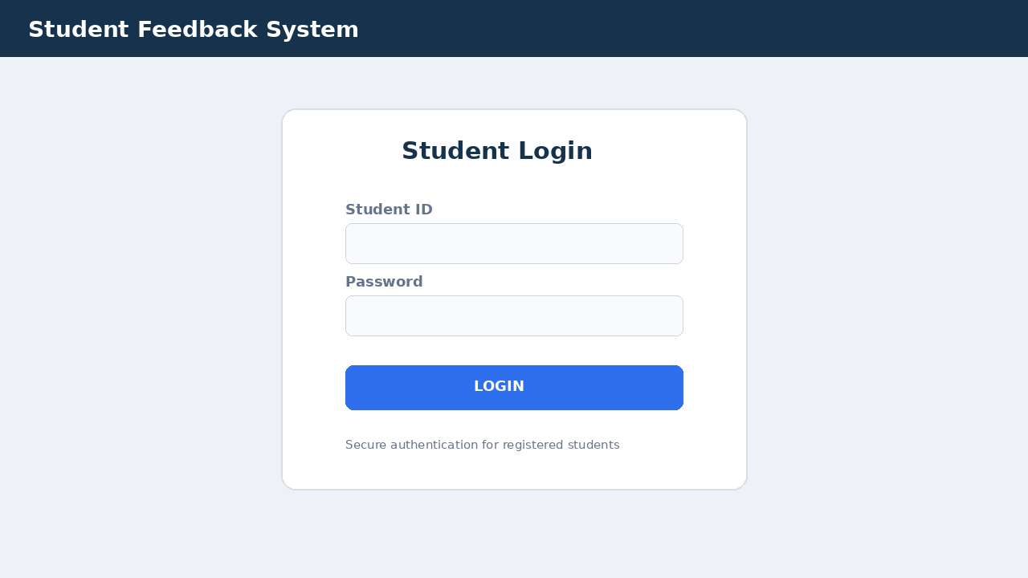
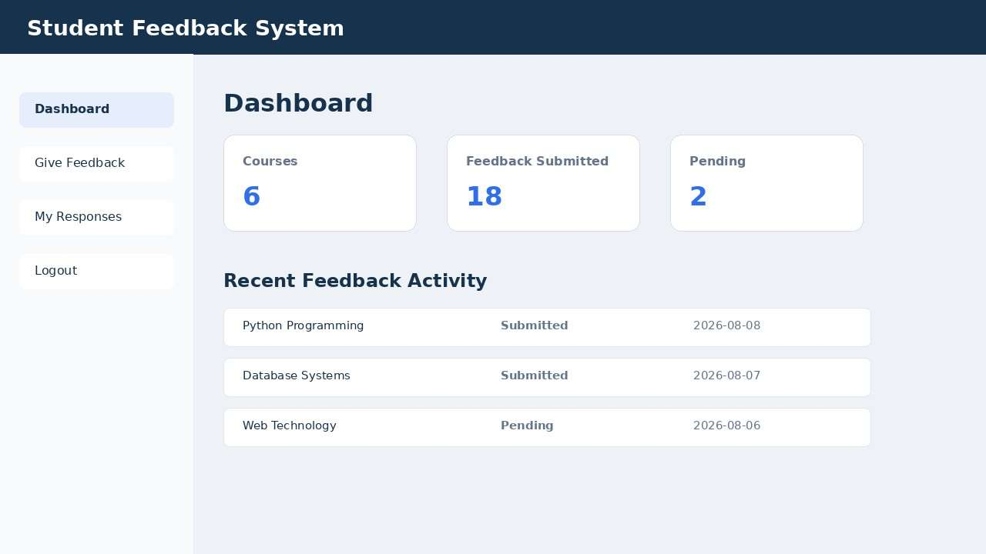
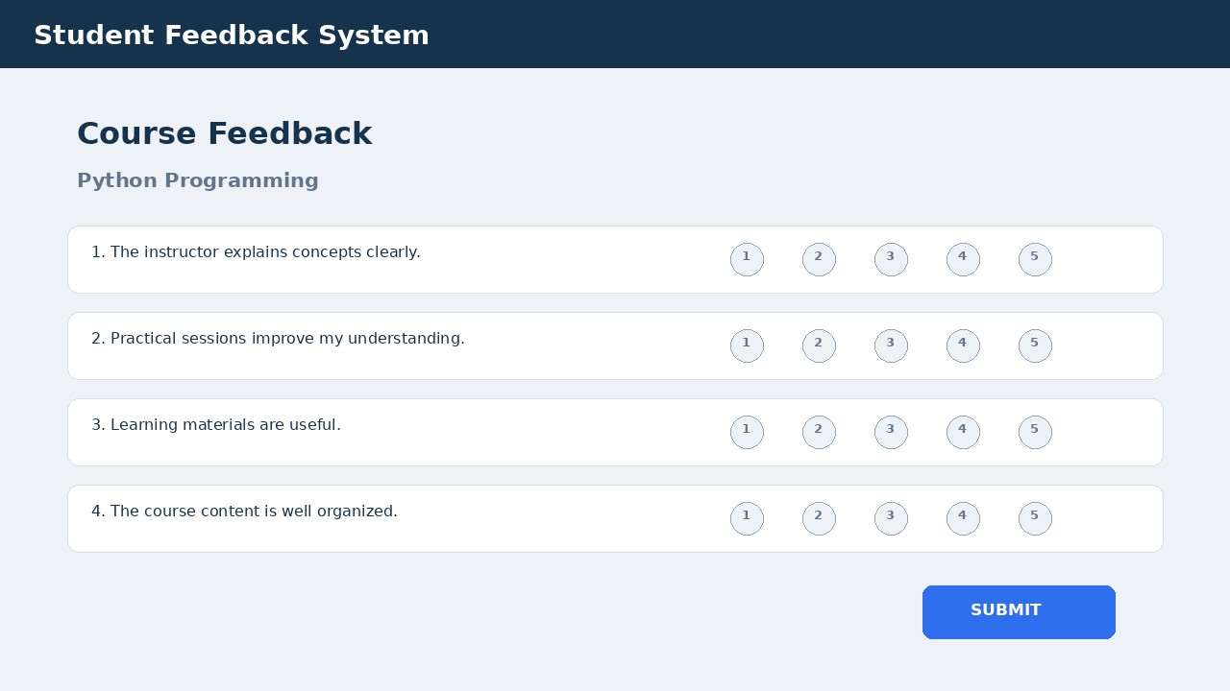
Application Screens
What they show
Secure login for registered students
Dashboard of courses, submitted and pending feedback
Rating from 1 to 5 for each question
Admin view of totals and average ratings
Student login
Student dashboard
Course feedback form
Administrator dashboard
Notes:
Four sample screens from the report: login, student dashboard, course feedback form and administrator dashboard. Figures shown on the dashboards are sample data.

Slide 13
Results: Testing and Ratings
8 / 8
functional test cases passed (TC-01 to TC-08)
PASSED BY TEST AREA
2
3
3
Login
Form
Storage
Course ratings are illustrative sample data used to demonstrate reporting; all are at least 4.0 out of 5.
Notes:
All 8 functional test cases passed: valid and invalid login, course selection, missing rating, rating outside 1-5, valid submission, admin summary and average calculation. The course averages are illustrative sample data and should be replaced with measured results if available.

Slide 14
Conclusion and Future Scope
CONCLUSION
FUTURE SCOPE
Turned a manual feedback process into a structured Python application
Gained hands-on practice in Python, Tkinter, SQLite and testing
All 8 functional test cases passed
Learned why requirements and validation matter
Web version with Flask or Django
MySQL / PostgreSQL for larger deployments
Role-based access control
Charts, trends and downloadable reports
Limitations Small-scale desktop prototype. Production use needs stronger authentication, logging and backups.
Email or in-app notifications
Thank you. Questions welcome.
Automated testing and continuous integration
Notes:
Summarise the work and what you learned. Future work: web version, a larger database, role-based access, richer reports, notifications and automated testing. Invite questions.

